Slide 1



A Subsidiary of
A Music Streaming Experience

Slide 2
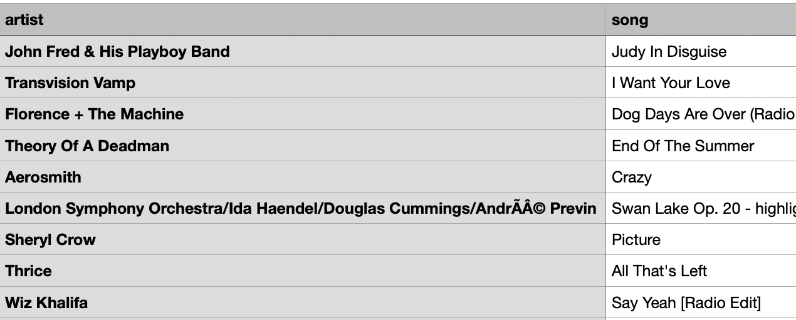
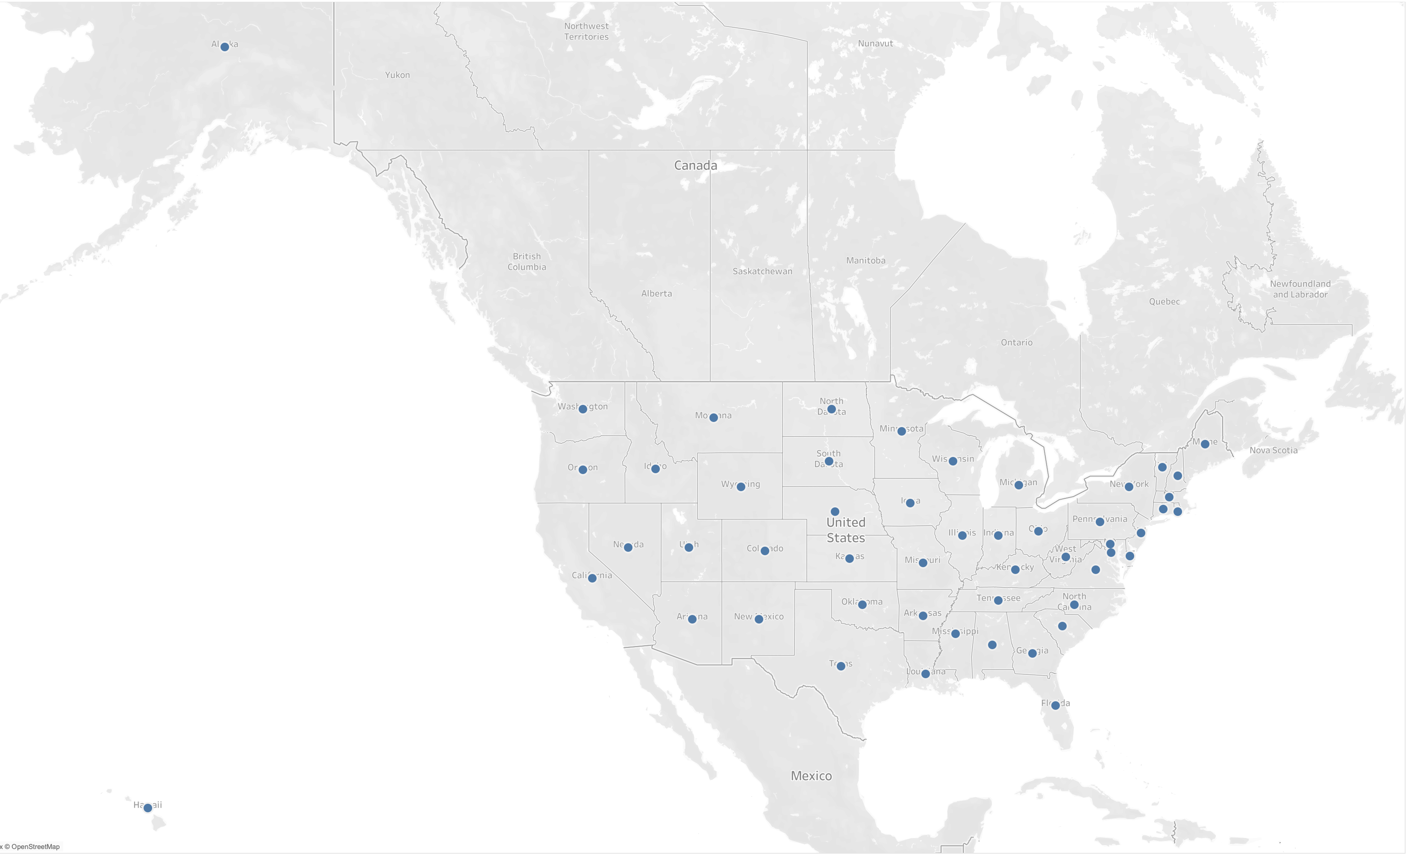
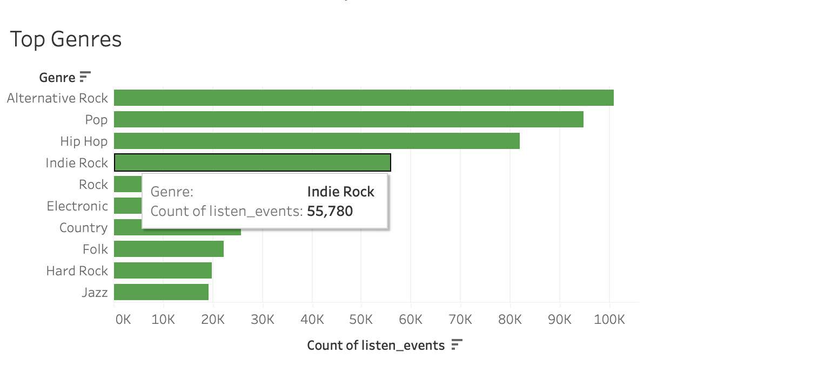
Sunflower Analytics
"artist":"John Fred & His Playboy Band","song":"Judy In Disguise","duration":171.80688,"ts":1714574635433,"sessionId":1498,"auth":"Logged In","level":"paid","itemInSession":2,"city":"Covert","zip":"49043","state":"MI","userAgent":"Mozilla/5.0 (Windows NT 6.1; WOW64; rv:31.0) Gecko/20100101 Firefox/31.0”,”lon”:-86.268503,"lat":42.285992,"userId":851,"lastName":"Stanley","firstName":"Vera","gender":"F","registration":1713855719433} {“artist":"Transvision Vamp","song":"I Want Your Love","duration":209.91956,"ts":1714574750433,"sessionId":23,"auth":"Logged In","level":"paid","itemInSession":17,"city":"Gas City","zip":"46933","state":"IN","userAgent":"\"Mozilla/5.0 (X11; Linux x86_64) AppleWebKit/537.36 (KHTML, like Gecko) Chrome/35.0.1916.153 Safari/537.36\"","lon":-85.582288,"lat":40.479845,"userId":24,"lastName":"Lucero","firstName":"Landon","gender":"M","registration":1714232178433}
{"artist":"Florence + The Machine","song":"Dog Days Are Over (Radio Edit)","duration":219.66322,"ts":1714574773433,"sessionId":915,"auth":"Logged In","level":"free","itemInSession":6,"city":"Rochester","zip":"48306","state":"MI","userAgent":"\"Mozilla/5.0 (Windows NT 5.1) AppleWebKit/537.36 (KHTML, like Gecko) Chrome/36.0.1985.143 Safari/537.36\"","lon":-83.147306,"lat":42.724318,"userId":916,"lastName":"Jimenez","firstName":"Mia","gender":"F","registration":1714366937433}
{

Slide 3



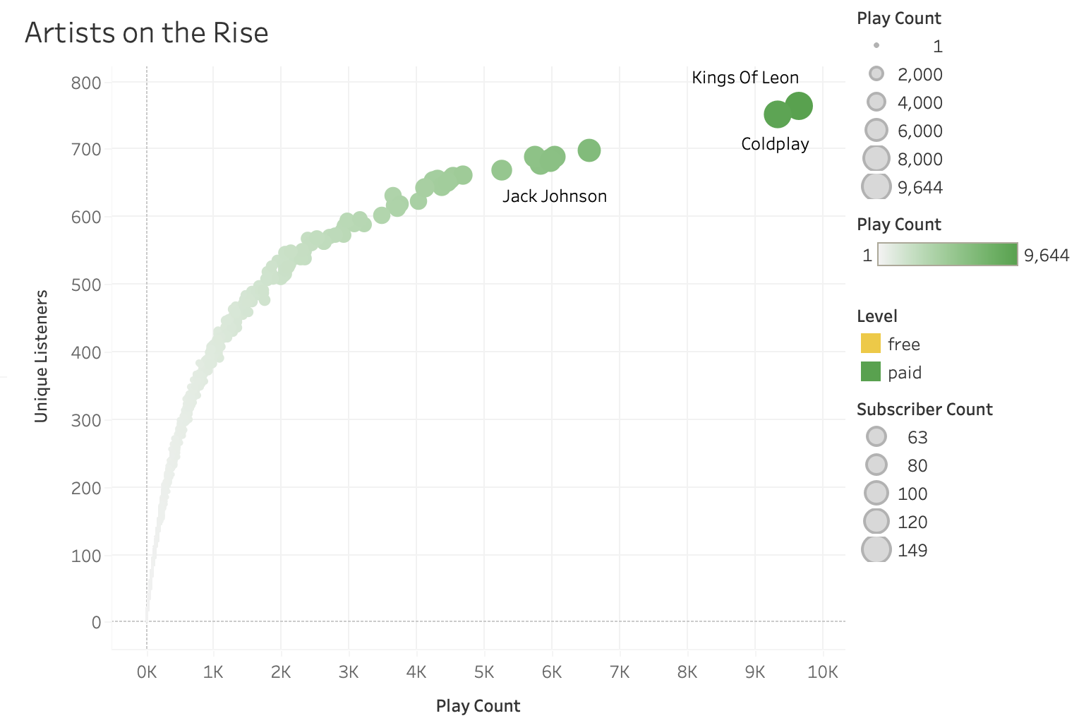




CREATE TABLE summary_genre_by_region AS SELECT region_name, genre, COUNT(*) as listen_count, COUNT(DISTINCT user_id) as unique_listeners FROM listen_events GROUP BY region_name, genre; CREATE TABLE summary_artist_popularity_by_geo A SELECT region_name, artist, COUNT(*) as play_count, COUNT(DISTINCT user_id) as unique_listeners, MAX(ts) as last_update FROM listen_events GROUP BY region_name, artist; CREATE INDEX idx_genre_region ON summary_genre_by_region(region_name, genre); CREATE INDEX idx_artist_region ON summary_artist_popularity_by_geo(region_name, artist);

Slide 4
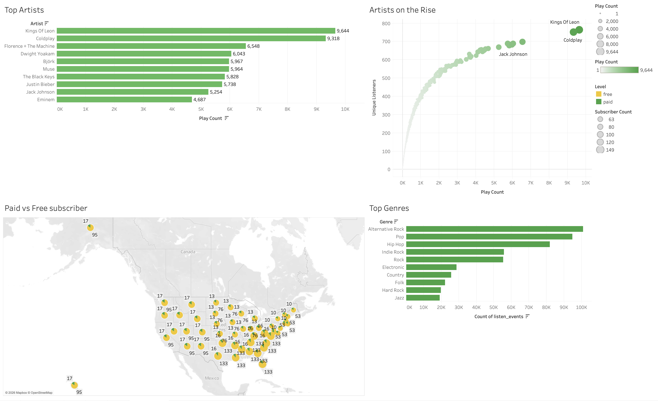

Slide 13
